Slide 1
P r o o f m e t h o d s

Slide 2
S t a t e m e n t
If A, B and C are sets, then
𝐴 − (𝐵 ∩ 𝐶) = (𝐴 − 𝐵) ∩ (𝐴 − 𝐶)

Slide 3
Proof by counter examples
A proof by counter example is not technically a proof . It is merely a way of showing that a given statement cannot be possibly correct by showing an instance that contradicts a universal statement.

Slide 4
Counter example
Considering
Set A = { 1 , 2 , 3 , 4 , 5 , 6 , 7 , 8 }
Set B = { 1 , 3 , 4 , 6 , 10 , 12 , 13 }
Set C = { 2 , 3 , 5 , 6 , 12 , 13 , 17}

Slide 5
Counter example
LHS => 𝐴 − (𝐵 ∩ 𝐶)
𝐵 ∩ 𝐶 => { 1 , 3 , 4 , 6 , 10 , 12 , 13 } ∩ { 2 , 3 , 5 , 6 , 12 , 13 , 17 }
=> { 3 , 6 , 12 , 13 }
𝐴 − (𝐵 ∩ 𝐶) => {1 , 2 , 3 , 4 , 5 , 6 , 7 , 8 } - { 3 , 6 , 12 , 13 }
=> { 1 , 2 , 4 , 5 ,7 ,8 }
RHS => (𝐴 − 𝐵) ∩ (𝐴 − 𝐶)
𝐴 − 𝐵 => {1 , 2 , 3 , 4 , 5 , 6 , 7 , 8 } - { 1 , 3 , 4 , 6 , 10 , 12 , 13 }
=> { 2 , 5 , 7 , 8 }
𝐴 − 𝐶 => {1 , 2 , 3 , 4 , 5 , 6 , 7 , 8 } - { 2 , 3 , 5 , 6 , 12 , 13 , 17 }
=> { 1 , 4 , 7 , 8 }
(𝐴 − 𝐵) ∩ (𝐴 − 𝐶) => { 2 , 5 , 7 , 8 } ∩ { 1 , 4 , 7 , 8 }
=> { 7 , 8 }
{ 1 , 2 , 4 , 5 ,7 ,8 } ≠ { 7 , 8 }
LHS ≠ RHS

Slide 6
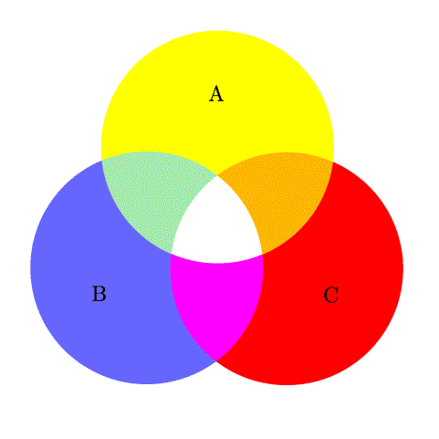
A B C
A – ( B ∩ C )

Slide 7
(𝐴 − 𝐵) ∩ (𝐴 − 𝐶)

Slide 8
NOTE
(A−B)∩(A−C) = A−(B∪C)
(A−B)∩(A−C)
=(A∩B′)∩(A∩C′) (By def of difference of sets, A−B=A∩B′ )
=A∩(B′∩C′) (by associative property)
=A∩(B∪C)′ (Demorgan's law , (A∪B)′=A′∩B′)
=A−(B∪C) (By def of difference of sets, A−B=A∩B′ )
Hence, proved.

